Slide 1
Secret Manager

Slide 2
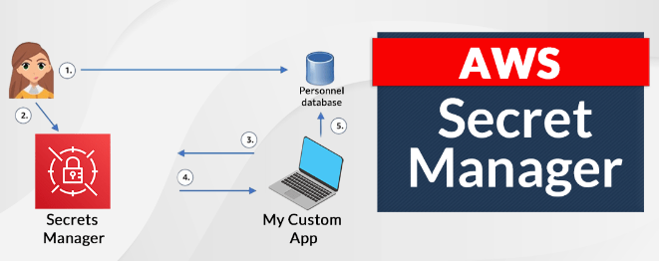
AWS Secrets Manager
AWS Secrets Manager helps you protect secrets needed to access your applications, services, and IT resources.
The service enables you to easily rotate, manage, and retrieve database credentials, API keys, and other secrets throughout their lifecycle.
Users and applications retrieve secrets with a call to Secrets Manager APIs, eliminating the need to hardcode sensitive information in plain text.
Capability to force rotation of secrets every X days.
Automate generation of secrets on rotation (uses Lambda).
Secrets are encrypted using KMS.

Slide 3
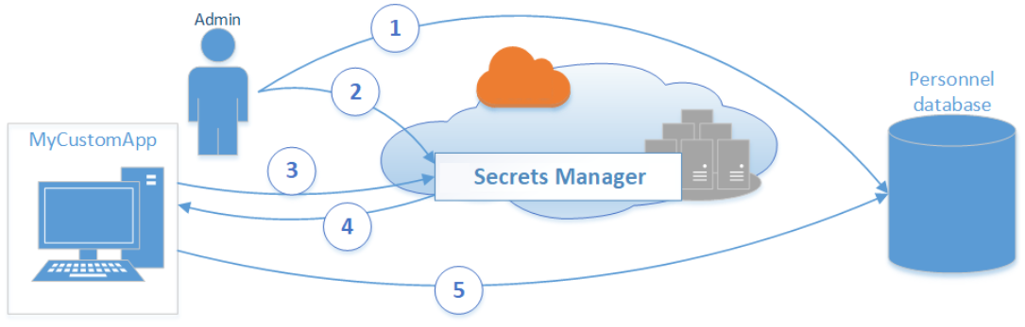
Basic AWS Secrets Manager scenario
The database administrator creates a set of credentials on the Personnel database for use by an application called MyCustomApp.
The administrator also configures those credentials with the permissions required for the application to access the Personnel database.
The database administrator stores the credentials as a secret in Secrets Manager named MyCustomAppCreds.
Then, Secrets Manager encrypts and stores the credentials within the secret as the protected secret text.
When MyCustomApp accesses the database, the application queries Secrets Manager for the secret named MyCustomAppCreds.
Secrets Manager retrieves the secret, decrypts the protected secret text, and returns the secret to the client app over a secured HTTPS with TLS channel.
The client application parses the credentials, connection string, and any other required information from the response and then uses the information to access the database server.

Slide 4
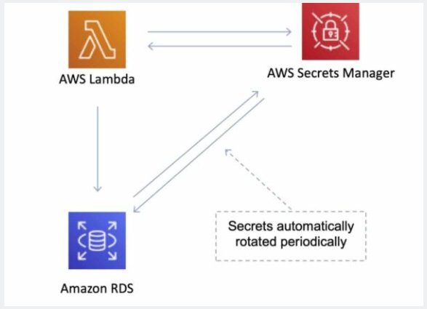
AWS Secrets Manager - rotation
You can extend Secrets Manager to rotate other secrets by modifying sample Lambda functions.
You can store and retrieve secrets using the AWS Secrets Manager console, AWS SDK, AWS CLI, or AWS CloudFormation.
AWS Secrets Manager enables you to audit and monitor secrets through integration with AWS logging, monitoring, and notification services.

Slide 5
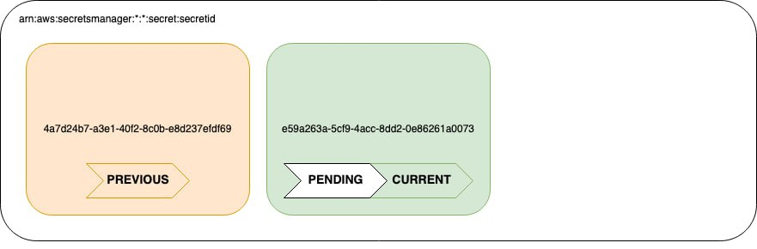
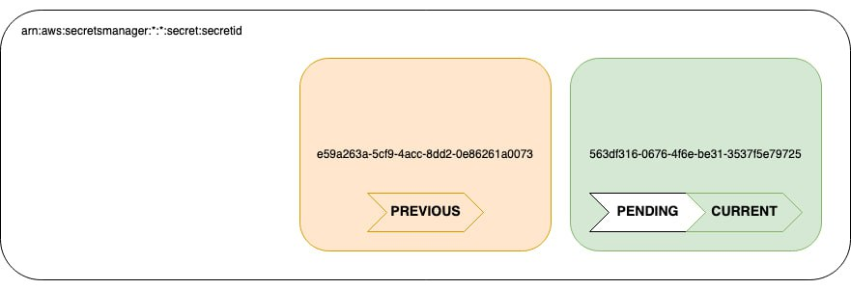
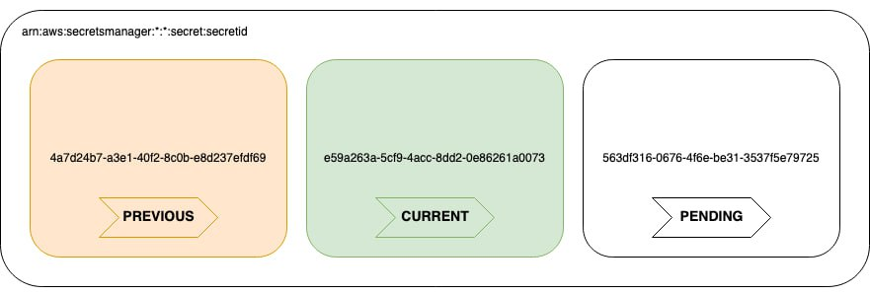
Secrets Manager Rotation
Rotation is the process of periodically updating a secret. When you rotate a secret, you update the credentials in both the secret and the database or service. In Secrets Manager, you can set up automatic rotation for your secrets.

Slide 6
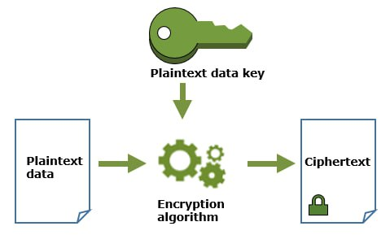
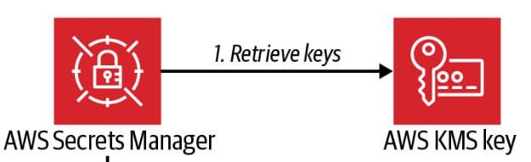
Secrets Manager Encryption
Secrets Manager & KMS:
Secrets Manager uses encryption via AWS KMS
Every secret in Secrets Manager is encrypted with a unique data key.
You can choose to use default encryption with the Secrets Manager AWS managed key for the account
You can create your own customer managed key in AWS KMS.
Using a customer managed key gives you more granular authorization controls over your KMS key activities
When Secrets Manager needs to encrypt a new version of the protected secret data:
Secrets Manager sends a request to AWS KMS to generate a new data key from the KMS key
Secrets Manager uses this data key for envelope encryption.
Secrets Manager stores the encrypted data key with the encrypted secret.

Slide 7
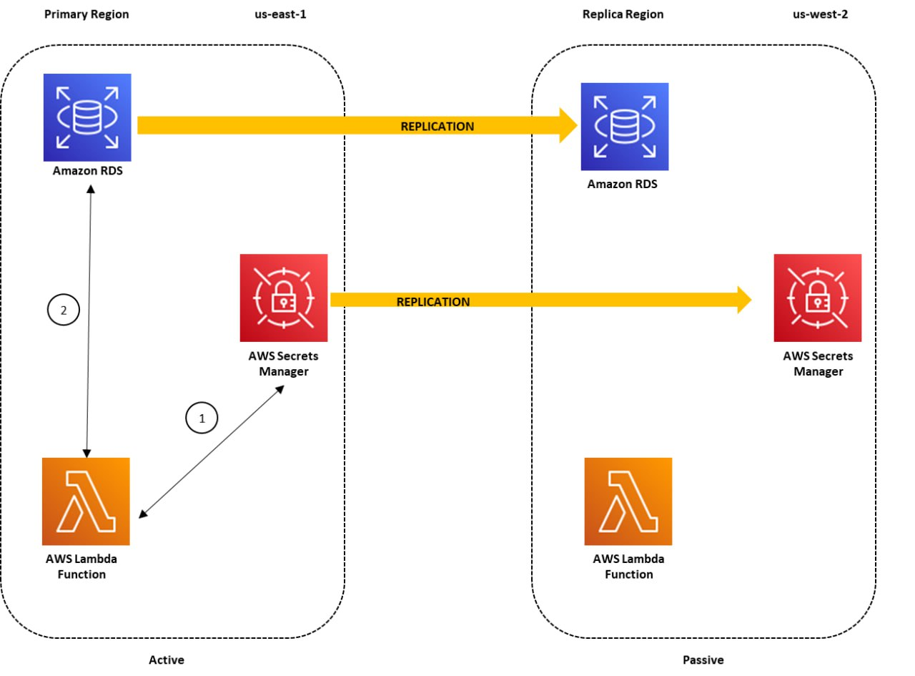
Secrets Manager Replication
With replication feature, you can create Regional read replicas for your secrets.
When you create a new secret or edit an existing secret, you can specify the Regions where your secrets need to be replicated.
Secrets Manager will securely create the read replicas for each secret and its associated metadata, eliminating the need to maintain a complex solution for this functionality.
Any update made to the primary secret, such as a secret value updated through automatic rotation, will be automatically propagated by Secrets Manager to the replica secrets, making it easier to manage the life cycle of multi-Region secrets.

Slide 8
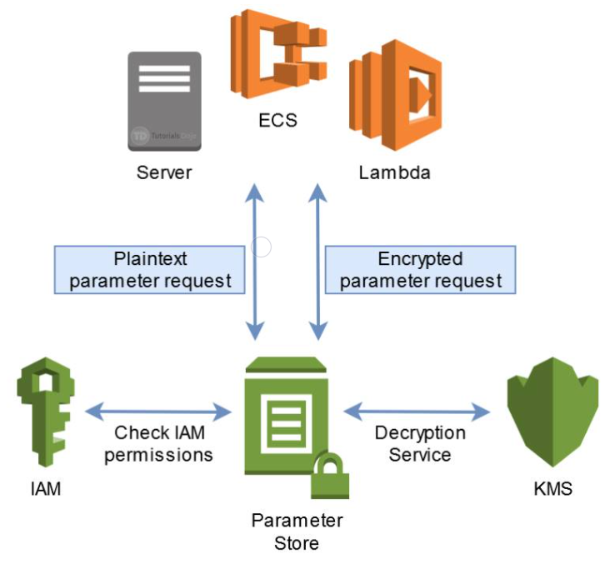
AWS Systems Manager Parameter Store
AWS Systems Manager provides a centralized store to manage your configuration data, whether plain-text data such as database strings or secrets such as passwords.
This allows you to separate your secrets and configuration data from your code.
Parameters can be tagged and organized into hierarchies, helping you manage parameters more easily.
For example, you can use the same parameter name, “db-string”, with a different hierarchical path, “dev/db-string” or “prod/db-string”, to store different values.
AWS Systems Manager is integrated with AWS Key Management Service (KMS), allowing you to automatically encrypt the data you store.

Slide 9
AWS SSM Parameter Store vs Secret Manager
Use Case:
SSM Parameter Store: It is primarily used for storing configuration data and application secrets such as database connection strings, API keys, and environment variables. It is well-suited for managing a wide range of parameters needed for application configuration and operation.
Secrets Manager: It is specifically designed for securely managing sensitive information and secrets, such as database credentials, API keys, and authentication tokens. It focuses on the secure storage, rotation, and retrieval of secrets used by applications and services.
Rotation:
SSM Parameter Store: It does not provide built-in support for automatic rotation of secrets. Users need to implement their own rotation mechanisms if secret rotation is required.
Secrets Manager: It offers automatic secret rotation for supported AWS and third-party services, reducing the risk of exposure to sensitive information and ensuring that credentials are regularly updated.
Integration:
SSM Parameter Store: It integrates seamlessly with other AWS services and features, such as AWS Lambda, AWS CloudFormation, and AWS Identity and Access Management (IAM), allowing you to securely access and manage configuration data and secrets in your applications and infrastructure.
Secrets Manager: It also integrates with AWS services like AWS Lambda, Amazon RDS, Amazon Redshift, and AWS CloudFormation, but it is specifically designed for managing secrets, providing dedicated APIs and features for secret management tasks.
Pricing:
SSM Parameter Store: It offers a cost-effective solution for storing configuration data and secrets, with a free tier and pay-as-you-go pricing based on API usage.
Secrets Manager: It has a pay-as-you-go pricing model based on the number of secrets stored and API usage, with a free tier for the first 30 days and a low per-API-call pricing.

